Slide 1

Introduction to Hadoop Distributed File System (HDFS)
HDFS is a distributed file system designed to store and manage large datasets.

Slide 2
Understanding the architecture of HDFS
Data Organization
Master-Slave Architecture
Metadata Management
HDFS splits files into large blocks and distributes them across nodes.
It consists of a single NameNode as a master server and multiple DataNodes.
NameNode maintains metadata, while DataNodes store the actual data.

Slide 3
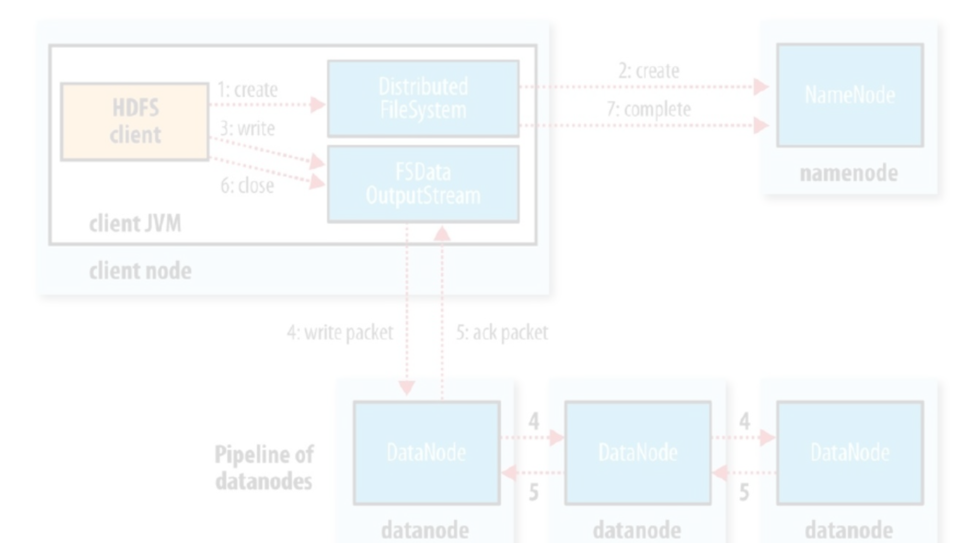
Creating a structured directory layout in HDFS
1
Namespaces
2
Folders and Files
3
Pathnames
HDFS uses a hierarchical namespace, similar to a traditional file system.
Files and directories are accessed through pathnames like /user/hadoop.
Directory structure organizes data through folder and file hierarchy.

Slide 4



Uploading and managing files in HDFS
Upload Files
Manage Files
Perform Operations
Transfer files from local storage to HDFS using commands or interfaces.
View, delete, or modify files within HDFS for efficient data management.
Execute file management operations such as changing permissions or renaming files.

Slide 5
Replication and fault tolerance in HDFS
Data Replication
Fault Tolerance
HDFS replicates data across multiple nodes for fault tolerance and data resilience.
In case of a DataNode failure, HDFS ensures data availability through replication.

Slide 6
Accessing and reading data from HDFS
1
Access Data
Retrieval of stored data using HDFS commands or APIs for application access.
2
Read Data
Reading data from the distributed file system using appropriate file operations.
3
Process Data
Processing data directly from HDFS for analytics or computation.

Slide 7
Writing and appending data to HDFS
1
2
Write Data
Append Data
Transfer data from local storage to HDFS using write commands.
Appending new data to existing files in HDFS for updates.

Slide 8



Monitoring and managing HDFS clusters
Monitoring
Management
Troubleshooting
Track cluster health, performance, and utilization for proactive management.
Handle cluster configuration, resource allocation, and user access controls.
Diagnose and resolve issues to maintain the stability and reliability of HDFS.

